Slide 1
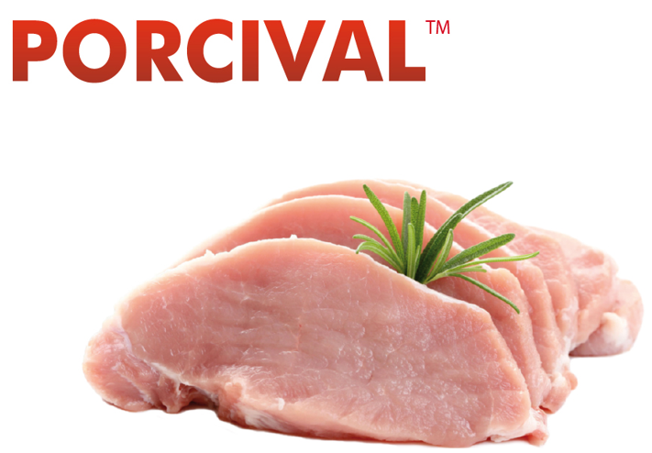
Time Series Analysis on the Prices of Pork in Colombia
By Carlos Vallecilla

Slide 2
Introduction and Problem Statement
EDA and Trends
Building the model
Results

Slide 3

Introduction and Problem Statement
Why to forecast prices?
Business forecasting allows you to know when to take more risks, or when it’s time to tighten your company’s belt.
Forecasting involves analyzing information about your business, the economy, the market place and current trends to prepare for your business’ future.

Slide 4
Problem Statement
The main purpose of this project is to learn about the prices of pork in Colombia, what drives these prices and be able to make an accurate prediction model based on past data.

Slide 5
EDA and Trends
The data for the weekly national price of pork was obtained from the following government agency http://asoporcicultores.co/
The data required some Date formatting as the info was contained in different columns.

Slide 6
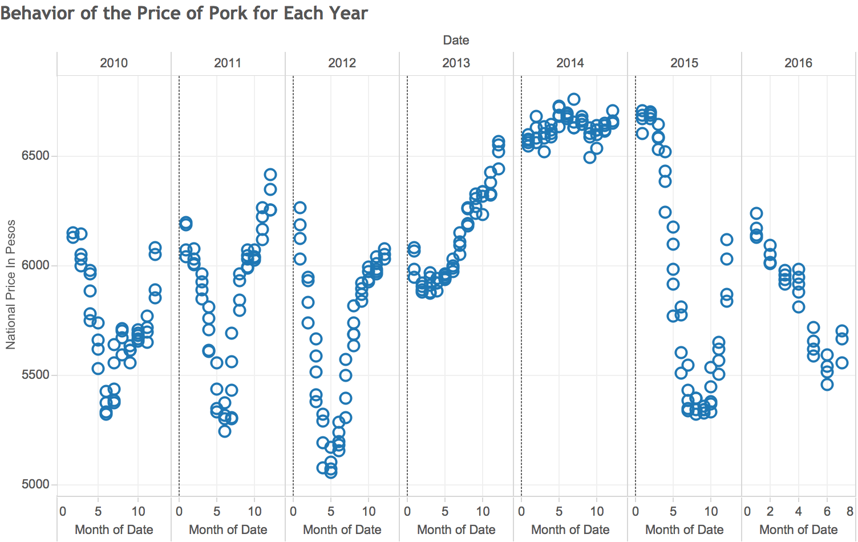

PED
Notes:
Porcine epidemic diarrhea virus discovered in the May 5, 2013 . Consumers felt the effects of the viral disease in the form of higher prices for pork products

Slide 7
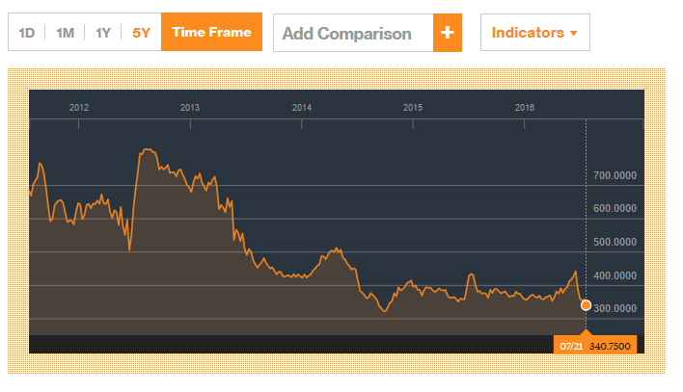

Yellow Corn
Source: Bloomberg
3,41 Dolars / Bushel

Slide 8
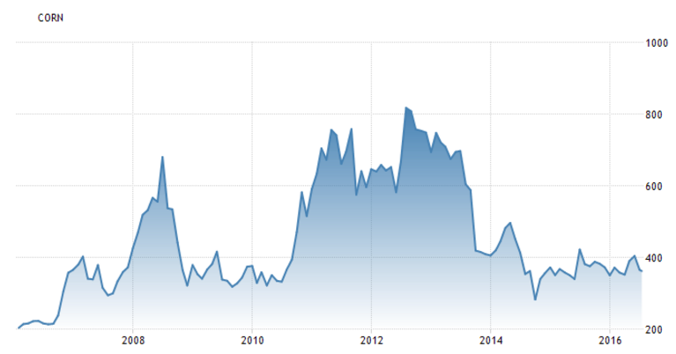
Biggest drough in the US in the last 50 years

Slide 9
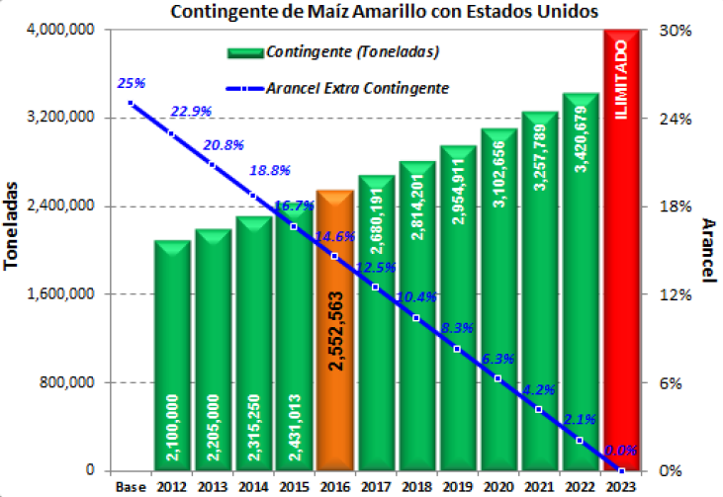

Yellow Corn
FREE TRADE AGREEMENT WITH COLOMBIA

Slide 10
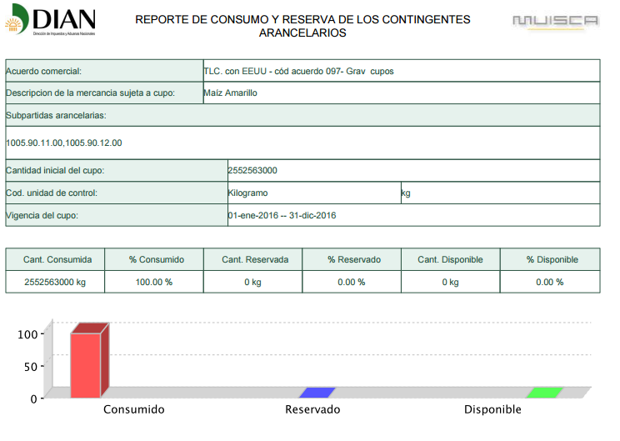
Yellow Corn
100% of the allowed is consumed by MAY

Slide 11
Buying
Yellow Corn (COP/Kg)

Slide 12

Building the Model
WARNING:
Time series modelling and ARIMA forecasting are scientific ways to predict the future. However, you must keep in mind that these scientific techniques are also not immune to force fitting and human biases.
Example : White Noise

Slide 13
Since all of the data I have collected have dates, this makes the project a Time Series(TS) problem.
Check Stationarity. A TS is said to be stationary if its statistical properties such as mean and variance remain constant over time.
Though stationarity assumption is taken in many TS models, almost none of practical time series are stationary.
If the Data obtained is not stationary, some transformations are needed.
The two mayor reasons why a model is non-stationary are because of trends (varying mean over time) and seasonality (variations at specific time-frames).

Slide 14
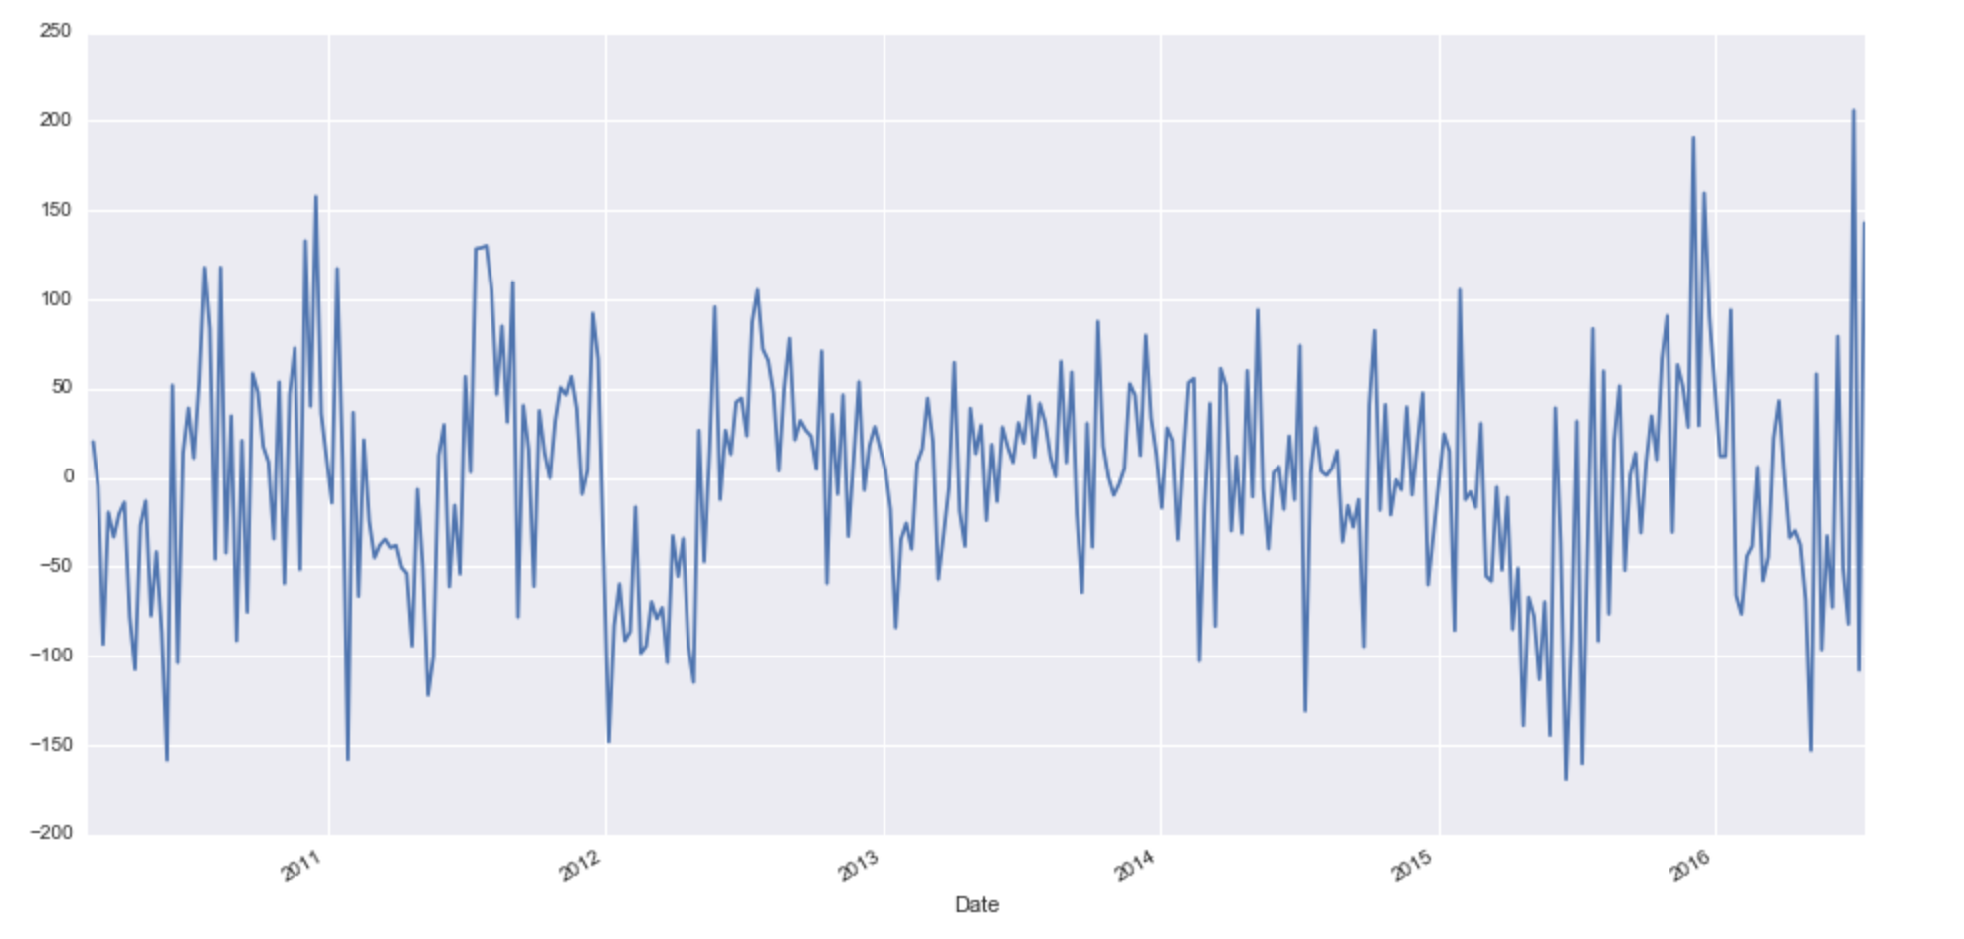
This series looks more stationary on both mean and variance. This also gives us the clue that I or integrated part of our ARIMA model will be equal to 1 as 1st difference is making the series stationary.

Slide 15
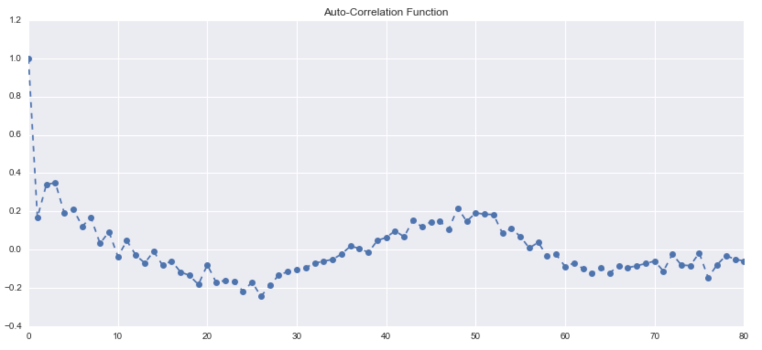
There is a seasonal component available at the lag 52 (represented by spikes around lag 52). This makes sense since we are analyzing monthly data that tends to have seasonality of 12 months (52 weeks) because of patterns in pork sales.

Slide 16
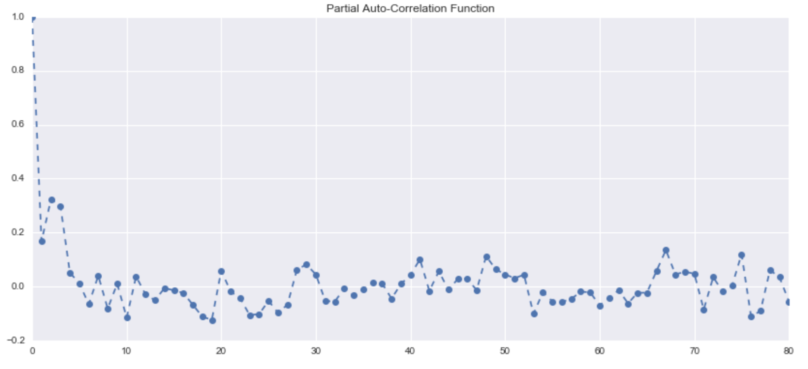

Slide 17

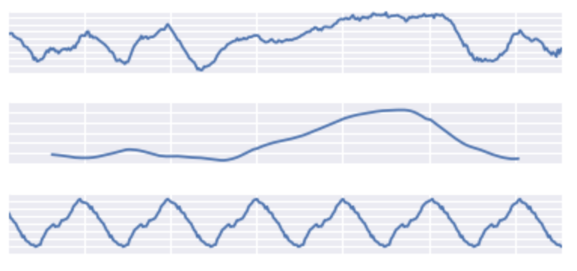
DECOMPOSITION GRAPH

Slide 18
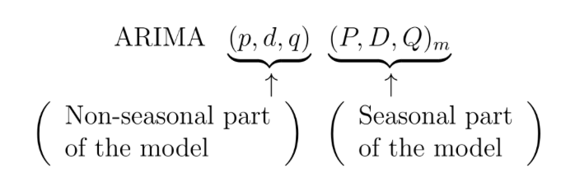
Auto ARIMA function in forecast package in R helped me identify the best fit ARIMA model
The best fit model is selected based on Akaike Information Criterion (AIC) , and Bayesian Information Criterion (BIC) values. The idea is to choose a model with minimum AIC and BIC values.

Slide 19
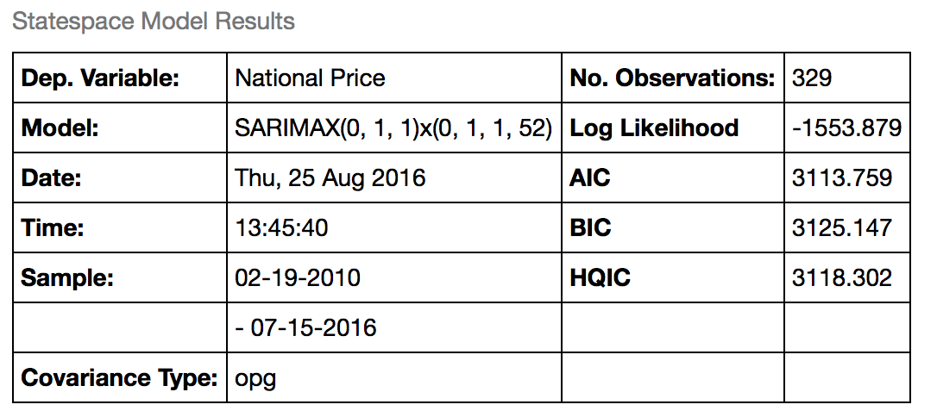
The values of AIC and BIC for our best fit model developed in R and reproduced in python are:
The model has I (or integrated) component equal to 1. This represents differencing of order 1. Moreover, the best fit model has MA value of order 1. Also, there is seasonal MA with lag 52 of order 1.

Slide 20
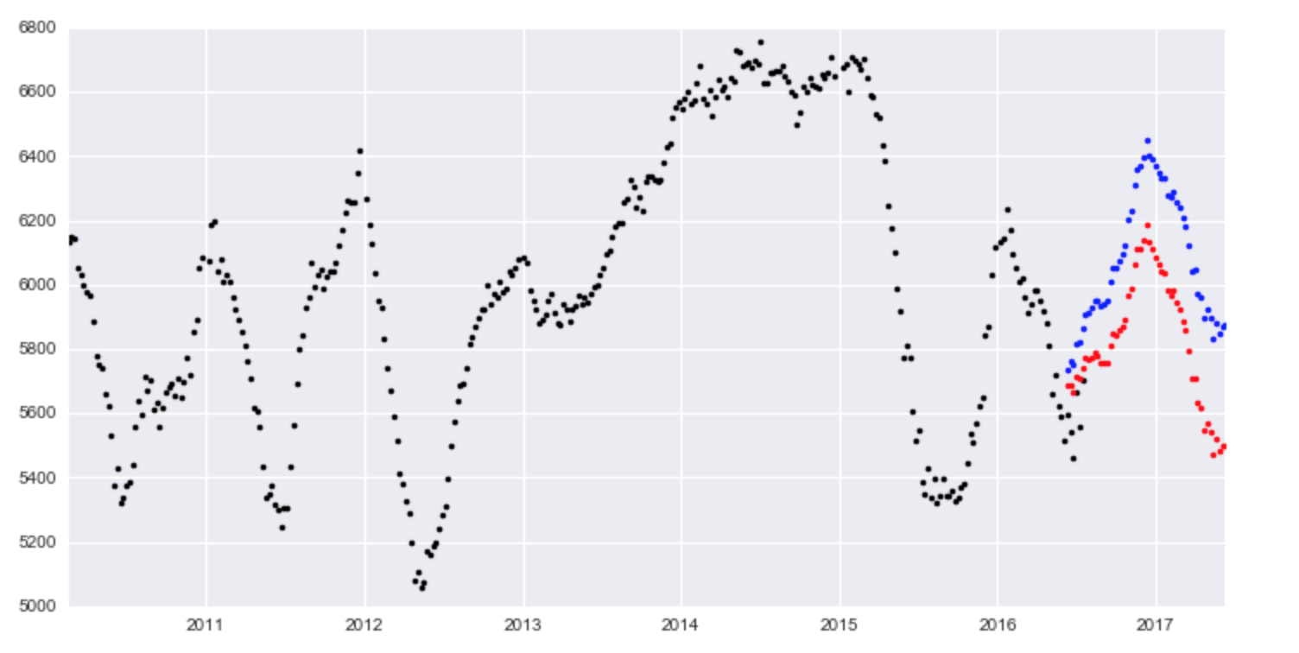
Results
Notes:
70% confident

Slide 21
Evaluating the model
Date | Real National Price | Lower National Price | upper National Price | Within Range
7/22/16 | 5734 | 5748.938659 | 5933.217343 | NO
7/29/16 | 5770 | 5739.222448 | 5936.364389 | YES
8/5/16 | 5759 | 5747.522227 | 5956.738041 | YES
8/12/16 | 5838 | 5760.473825 | 5981.103761 | YES
8/19/16 | 5953 | 5748.502681 | 5979.984604 | YES
Notes:
70% confident

Slide 22
Forecasting for a long period like 1 year is an ambitious task.
The major assumption here is that the underlining patterns in the time series will continue to stay the same as predicted in the model.
A short term forecasting model, say a couple of business quarters, is usually a good idea to forecast with reasonable accuracy.
A long term model needs to be evaluated on a regular interval of time (say monthly). The idea is to incorporate the new information available with the passage of time.

